Slide 1
(not your ordinary) Linear Regression Introduction
PhillyR R User Group
Leon Kim

Slide 2
Overview
PhillyR Logistics
Presentation
Q&A

Slide 3
PhillyR News
Things?
Some exciting stuff
Thing!
More exciting stuff

Slide 4
Goal
Gain understanding of and appreciation for lm() function
Be able to create a regression model on your own from scratch *
Key points
Mastering linear regression takes more than 1 hour, so this isn’t end-all and be-all guide
Stat 101 – level math knowledge. No linear algebra!
Look at linear regression in a different way

Slide 5
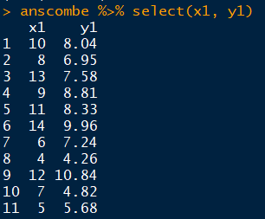
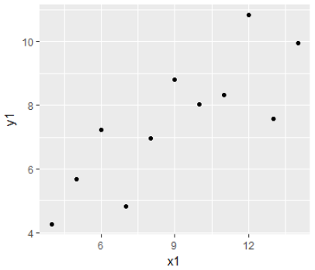
All of statistics*
1) Find relationship between x1 and y1
Relationship status
direction
strength
significance
2)
What is y1 when x1 is some unobserved value e.g. x1 has some hypothetical value = 10.5

Slide 6
Do both with one line
Find relationship between x1 and y1
Relationship status
direction : slope sign
strength : slope magnitude
significance : p-value
What is y1 when x1 is some unobserved value e.g. x1 has some hypothetical value = 10.5
=> Use the high school algebra on y1 = b₁x1 + b₀ where b₀ = y intercept and b₁ = slope
Question:
which of the lines on the right best represents the data?

Slide 7
What is the line of best fit?
Which line represents the data best?
This is where concepts like: - Ordinary Least Squares, - Maximum Likelihood Estimator, - Sum of Squared Residuals … and others are thrown around
tl;dr; Choose the line that has the smallest error
i^{th} real value : y_{i} = b₁x_{i} + b₀ + e_{i}
i^{th} predicted value : ŷ_{i} = b₁x_{i} + b₀
tl;dr; All of Statistics:
All models minimize errors in prediction by optimizing for a loss function.
In linear regression, this is: Σ [(y_{i} – ŷ_{i})²]
b₁ = how much y is expected to change if x increased by 1 b₀ = what y is expected to be if x = 0

Slide 8
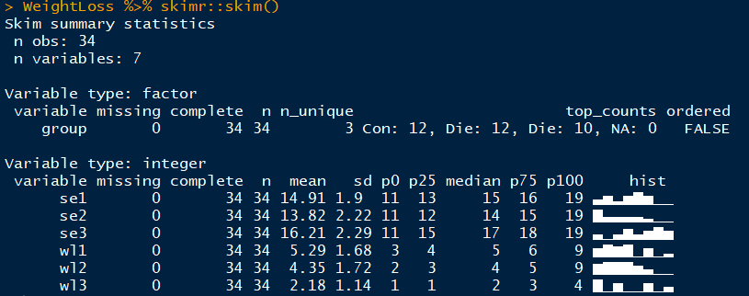
Enough theory, let’s get down to R
WeightLoss dataset in library(car)
wl1: weight loss at 1 month
se1: self esteem at 1 month
group: weight loss method “control” vs “Diet” vs “DietEx”
- https://github.com/ropenscilabs/skimr

Slide 9
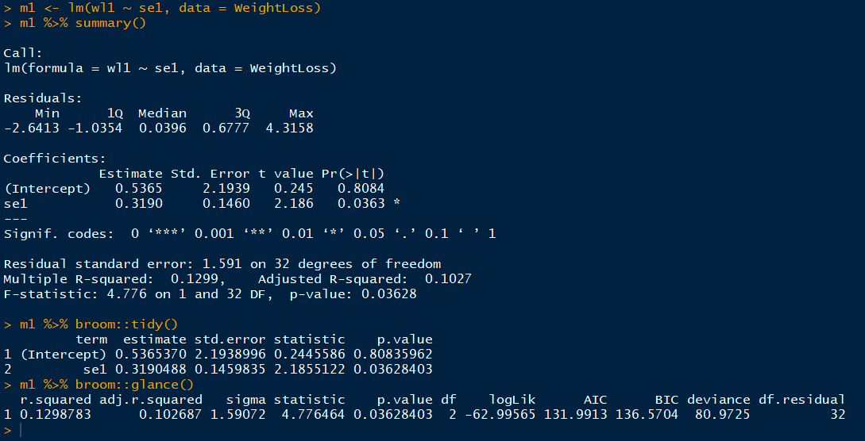
Fitting linear regression in R - 1
Using lm() to regress weight loss on self-esteem
Simplest and the preferred method

Slide 10
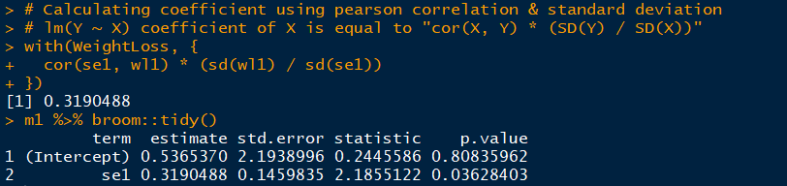
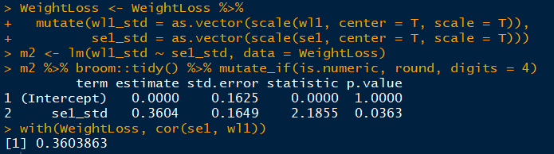
Fitting linear regression in R - 2
Using correlation & SD to regress weight loss on self-esteem
This works because regression coefficient is the slope of a line
SD(Y) / SD(X) is the “rise over run”
correlation scales the ratio based on how linear relationship is
Only works when you have only one independent variable
When your data is standardized, cor(Y,X) = coefficient of X in lm()

Slide 11
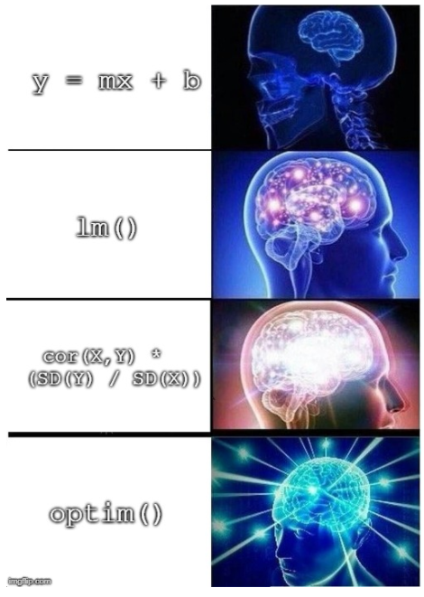

Slide 13
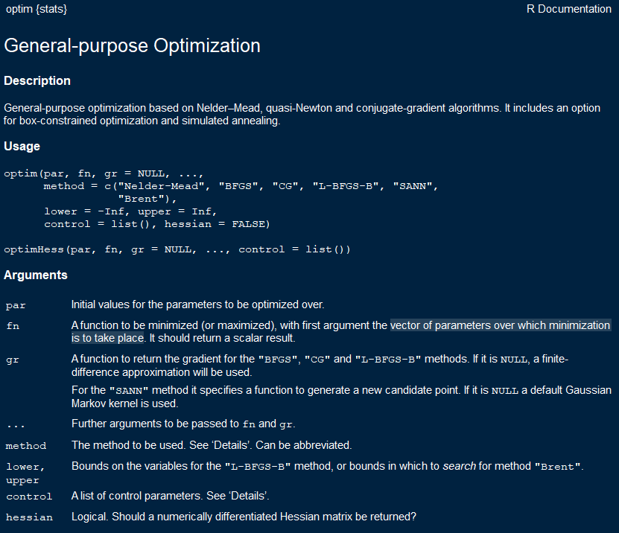

Slide 14
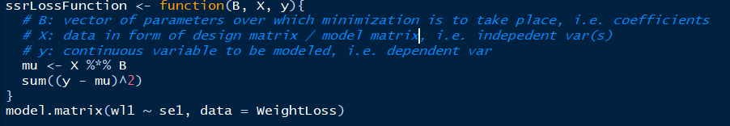
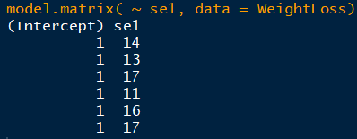
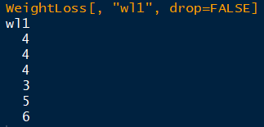
Fitting linear regression in R - 3
Using optim() and model matrix to regress weight loss on self-esteem
optim() is a general-purpose optimizer
Find coefficients that minimizes the loss function Σ [(y_{i} – ŷ_{i})²]
Requires user to specify design matrix aka model matrix
design matrix or model matrix
This is abstracted away from you when you use formula in lm()
X y

Slide 15
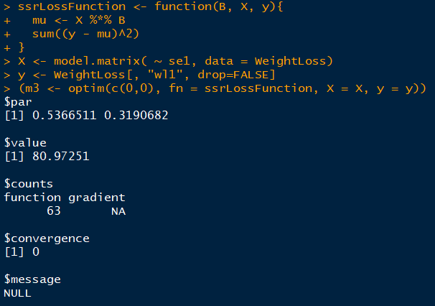
optim() needs initial values to optimize over. Here, we set these values at (0, 0) because we are optimizing over 2 columns in model matrix X
optim() returns a list with
argmin (parameters that minimizes the loss function value given X)
Minimum value of the loss function
Other info

Slide 16
1st coefficient
i.e. intercept
2nd coefficient
i.e. slope
optim() needs initial values to optimize over. Here, we set these values at (0, 0) because we are optimizing over 2 columns in model matrix X
optim() returns a list with
argmin (parameters that minimizes the loss function value given X)
Minimum value of the loss function
Other info

Slide 17
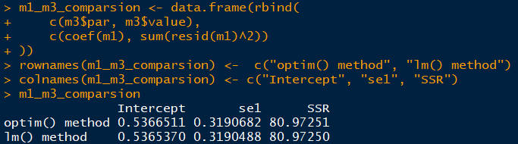
1st coefficient optim() result
2nd coefficient
optim() result

Slide 18
So far
Linear regression at its most primitive form, is just a line equation that minimizes error based on some loss function
No probability or statistics concepts are required
optim() is a general optimization function in R (more on this in the future)
You should still use lm() to fit and assess linear regression models
lm() outputs object of class… “lm” that has many useful metrics and functions associated with it
but remember your roots! All lm() is using statistical properties and linear algebra to optimize loss functions

Slide 19

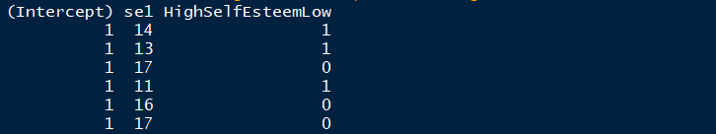
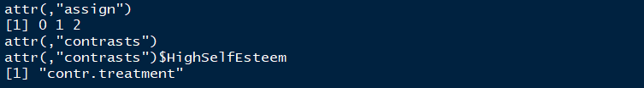
model.matrix: hidden workhorse in lm()
model.matrix() converts your dataset into a matrix of numbers. Most notably:
Adds intercept column : Existence (or lack of) intercept column has statistical significance to your regression analysis https://stats.stackexchange.com/questions/7948/when-is-it-ok-to-remove-the-intercept-in-a-linear-regression-model
Converts factor variables (aka categorical variables) into numbers

Slide 20
model.matrix: hidden workhorse in lm()
model.matrix() converts your dataset into a matrix of numbers. Most notably:
Adds intercept column : Existence (or lack of) intercept column has statistical significance to your regression analysis https://stats.stackexchange.com/questions/7948/when-is-it-ok-to-remove-the-intercept-in-a-linear-regression-model
Converts factor variables (aka categorical variables) into numbers
model.matrix() creates a matrix given your dataset

Slide 21
model.matrix: hidden workhorse in lm()
model.matrix() converts your dataset into a matrix of numbers. Most notably:
Adds intercept column : Existence (or lack of) intercept column has statistical significance to your regression analysis https://stats.stackexchange.com/questions/7948/when-is-it-ok-to-remove-the-intercept-in-a-linear-regression-model
Converts factor variables (aka categorical variables) into numbers
R does a lot of stuff by default
For create dummy variable for k-1 choices
where k is number of categories (“levels” in R)

Slide 22
model.matrix: hidden workhorse in lm()
model.matrix() converts your dataset into a matrix of numbers. Most notably:
Adds intercept column : Existence (or lack of) intercept column has statistical significance to your regression analysis https://stats.stackexchange.com/questions/7948/when-is-it-ok-to-remove-the-intercept-in-a-linear-regression-model
Converts factor variables (aka categorical variables) into numbers
R does a lot of stuff by default
Non-numeric values converted to factors
character variables are changed to factor variables by default

Slide 23
model.matrix: hidden workhorse in lm()
model.matrix() converts your dataset into a matrix of numbers. Most notably:
Adds intercept column : Existence (or lack of) intercept column has statistical significance to your regression analysis https://stats.stackexchange.com/questions/7948/when-is-it-ok-to-remove-the-intercept-in-a-linear-regression-model
Converts factor variables (aka categorical variables) into numbers
R does a lot of stuff by default
Creates dummy variables to make categories into numeric columns
14.91
0 for data rows that are not “Low”,
1 for data rows that are “Low”

Slide 24
model.matrix: hidden workhorse in lm()
model.matrix() converts your dataset into a matrix of numbers. Most notably:
Adds intercept column : Existence (or lack of) intercept column has statistical significance to your regression analysis https://stats.stackexchange.com/questions/7948/when-is-it-ok-to-remove-the-intercept-in-a-linear-regression-model
Converts factor variables (aka categorical variables) into numbers
R does a lot of stuff by default
Follows default factor() rules
14.91
“Low” gets a new column because default behavior of R is to order levels alphabetically

Slide 25
Treating categorical variables
There are whole bunch of different encoding techniques to use
https://stats.idre.ucla.edu/r/library/r-library-contrast-coding-systems-for-categorical-variables
http://appliedpredictivemodeling.com/blog/2013/10/23/the-basics-of-encoding-categorical-data-for-predictive-models
They have different effects on analysis, predictive power etc.
R functions: contr.treatment(), contr.sum() contr.poly() contr.helmert() contr.SAS()

Slide 26
Treating categorical variables
There are whole bunch of different encoding techniques to use
https://stats.idre.ucla.edu/r/library/r-library-contrast-coding-systems-for-categorical-variables
http://appliedpredictivemodeling.com/blog/2013/10/23/the-basics-of-encoding-categorical-data-for-predictive-models
They have different effects on analysis, predictive power etc.
R functions in library(stats): contr.treatment() contr.sum() contr.poly() contr.helmert() contr.SAS()
R default, where first level in alphabetical order is reference group

Slide 27
Treating categorical variables
There are whole bunch of different encoding techniques to use
https://stats.idre.ucla.edu/r/library/r-library-contrast-coding-systems-for-categorical-variables
http://appliedpredictivemodeling.com/blog/2013/10/23/the-basics-of-encoding-categorical-data-for-predictive-models
They have different effects on analysis, predictive power etc.
R functions in library(stats): contr.treatment() contr.sum() contr.poly() contr.helmert() contr.SAS()
(most of) SAS’s default, where last level in alphabetical order is reference group*
* This fact is according to the R documentation. As a non SAS programmer, I do not know if this actually true. However, I have had conversations with other statisticians in which they noticed that R’s output and SAS’s output for the same regression model spec are different, leading some SAS users to “distrust” R (or vice-versa). This wouldn’t actually be an issue if these users actually looked at the model outputs carefully and identified that reference group for the categorical variable is different between R and SAS.

Slide 28
Conclusion
Use lm() to fit and assess linear regression models
lm() outputs object of class… “lm” that has many useful metrics and functions associated with it
but remember your roots! lm() just a shortcut for creating regression models without manually constructing design matrix and optimizing over loss functions

Slide 29
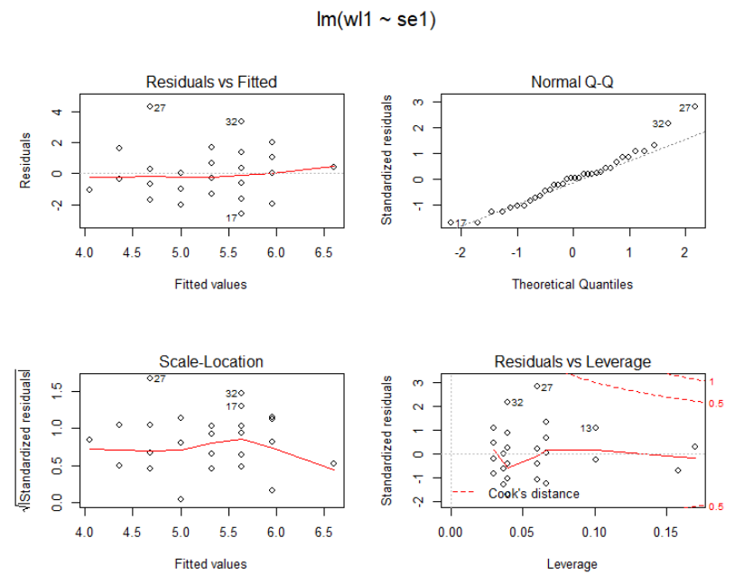
plot(m1); # Creates diagnostic plots http://data.library.virginia.edu/diagnostic-plots/

Slide 30
Questions and Discussion

